Slide 1
Union-Find structure
Mikko Malinen
School of Computing
University of Eastern Finland

Slide 2
Basic set operations
Given several sets. Find the one,
where a belongs.
Form union of sets and .
Usually supposed that .
Does element belong to set .
Add element to set . .
Remove element from set if it is
in that set.
Suppose that set is linearly ordered.
Find the smallest element of set .

Slide 3
Union-Find structure
An abstract data type
type set(T) has
procedure createset(x: T) returns set
procedure findset(x: T) returns set
procedure union(S1,S2: set) returns set

Slide 4
createset(x) forms a set consisting of one element {x}
findset(x) returns the set where x belongs
union(S1,S2) forms the union of the sets S1 and S2.
In union-operation the sets S1 and S2 are destroyed. So no element can belong to more than one set.
We are interested in a task, which consists of a sequence of operations createset, union and findset.

Slide 5
Trivial solution
Represeting a set by a list
can be formed in constant time by combining the lists
findset O(n), when there are n elements

Slide 6
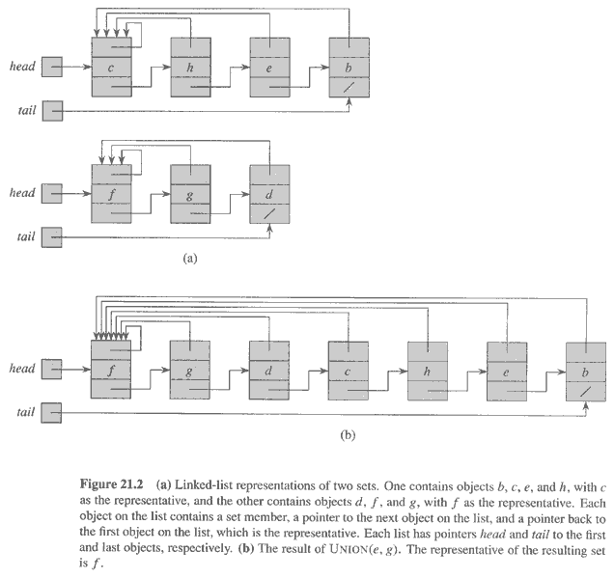
Copyright © The McGraw-Hill Companies, Inc. Permission required for reproduction or display.

Slide 7
Trivial solution
Representing a set by a bit vector
Let U be an ordered base set and |U| = n
Representing subset as an n-bit vector
’s i:th bit is 1, if U’s i:th element belongs to S.
Union can be implemented as bit vector operations (in one step, if n is not too big); rquires time O(|U|) and each set requires space O(|U|).
Findset requires time O(n).

Slide 8
Trivial solution
Representing a set as a table
union requires time O(n)
findset can be implemented in constant time, if elements have order, otherwise O(n)

Slide 9
Tree representation
Sets are represented by a forest (a single set is represented as a tree)
We choose the root node of a tree to be the representative of the set
if vertex x is the root of the tree T, then by notation [x] we mean the set formed be the vertices of the tree T.

Slide 10
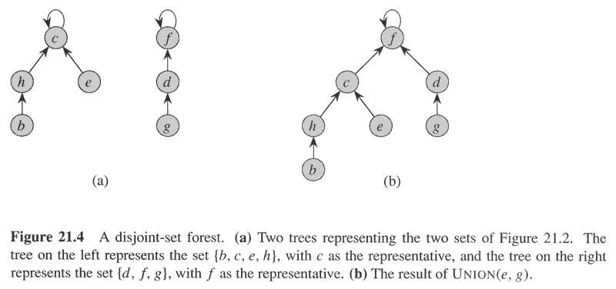
Copyright © The McGraw-Hill Companies, Inc. Permission required for reproduction or display.

Slide 11
Tree implementation
Operation makeset(x) forms a tree, the only vertex will be the root x
In operation findset(x) a path is followed from vertex x upwards until the root y is reached. Then [y] is the result.
Operation union([x],[y]) is implemented by setting vertex x as a child of vertex y. Then [y] is the union set.
Problem: the tree may come inbalanced

Slide 12
Solutions to inbalanced trees
Solution 1: Balancing. In operation union([x],[y])
the new root will be that element x or y, of
which tree is highest.
Solution 2: Path compression. When a root y has
been found as a result of operation findset(x),
the father of all the vertices in the path leading
from x to y will be set y.

Slide 13
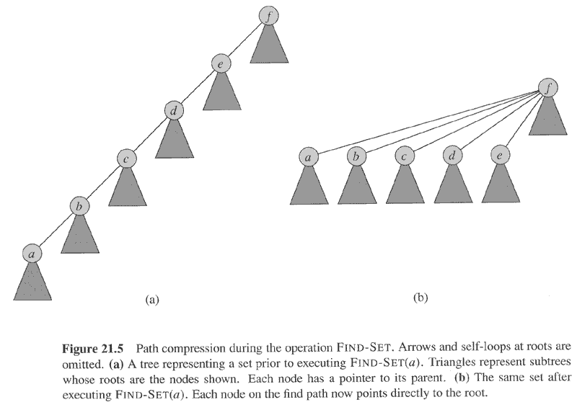
Copyright © The McGraw-Hill Companies, Inc. Permission required for reproduction or display.

Slide 14
Time complexity
We examine an operation sequence, where there are n makeset-operations and m findset
–operations
New elements are created only with makeset operation, so n is the number of elements and n-1 is an upper bound for union-operations.
In spite of balancing, a tree may be formed, of which height is log n. If we estimate all find -operations this difficult, the whole task would require time O(m log n). This estimate is too pessimistic.

Slide 15
Time complexity
A more accurate analysis is based on the idea of balancing the costs
Let A be Ackerman function and its one kind of inverse function
grows extremely slowly. <= 3 with all thinkable values of arguments m and n.
If union-find task has n union- and m findset
-operations, it can be executed in time
. (proof omitted).

Slide 16
Applications

Slide 17
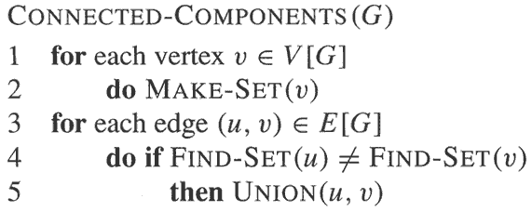
Copyright © The McGraw-Hill Companies, Inc. Permission required for reproduction or display.

Slide 18
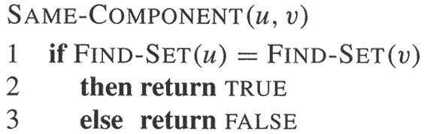
Copyright © The McGraw-Hill Companies, Inc. Permission required for reproduction or display.

Slide 19
PNN Clustering

Slide 20
Pseudo code

Slide 21
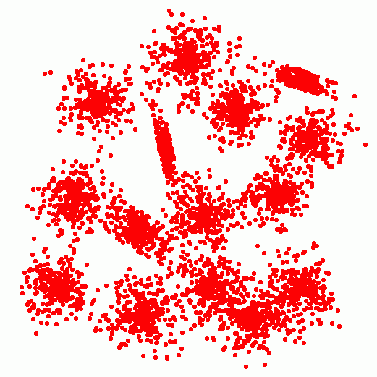
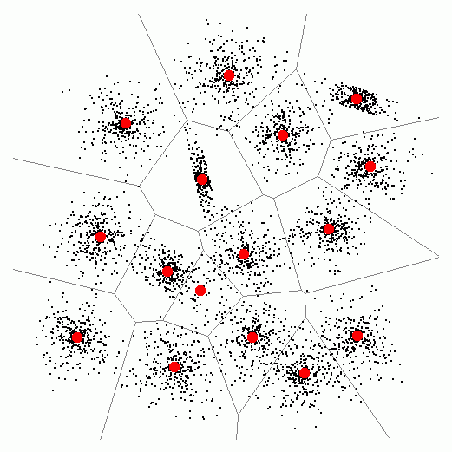
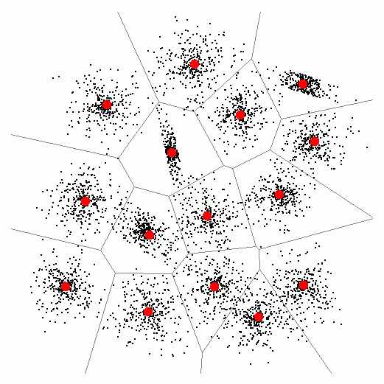
Example of the overall process
M=5000
M=50
M=5000
M=4999
M=4998
.
.
.
M=50
.
.
M=16
M=15
M=16
M=15

Slide 22
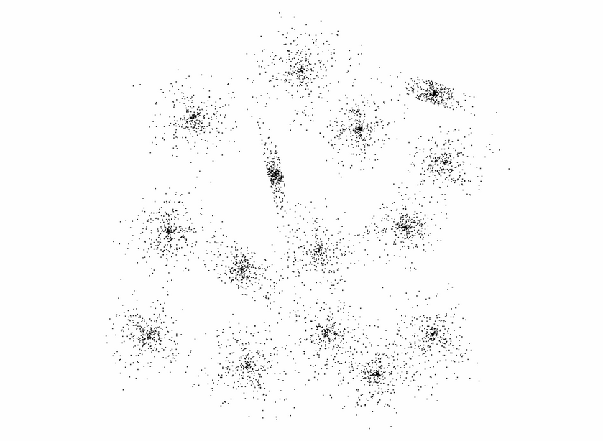
Detailed example of the process

Slide 23
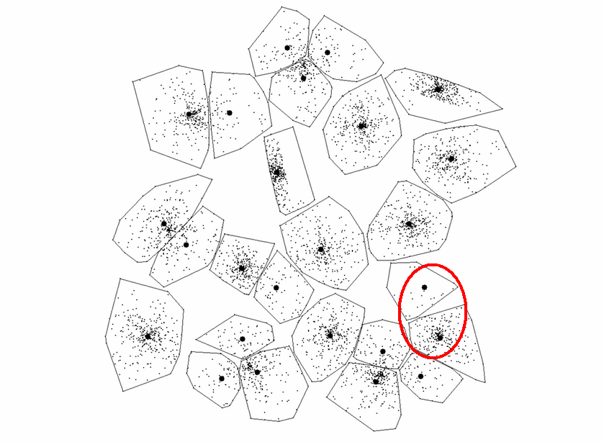
Example - 25 Clusters
MSE ≈ 1.01*10⁹

Slide 24
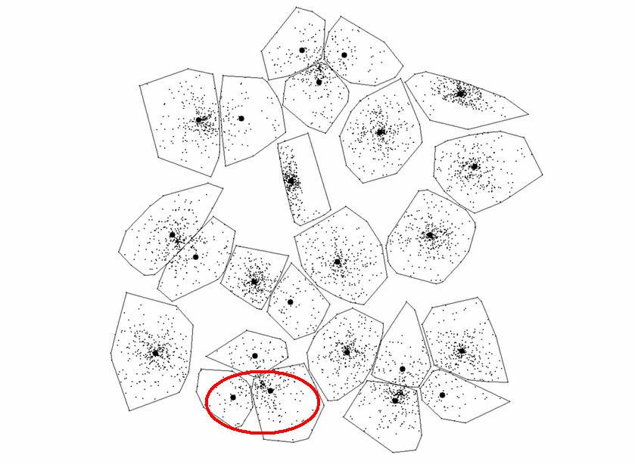
Example - 24 Clusters
MSE ≈ 1.03*10⁹

Slide 25
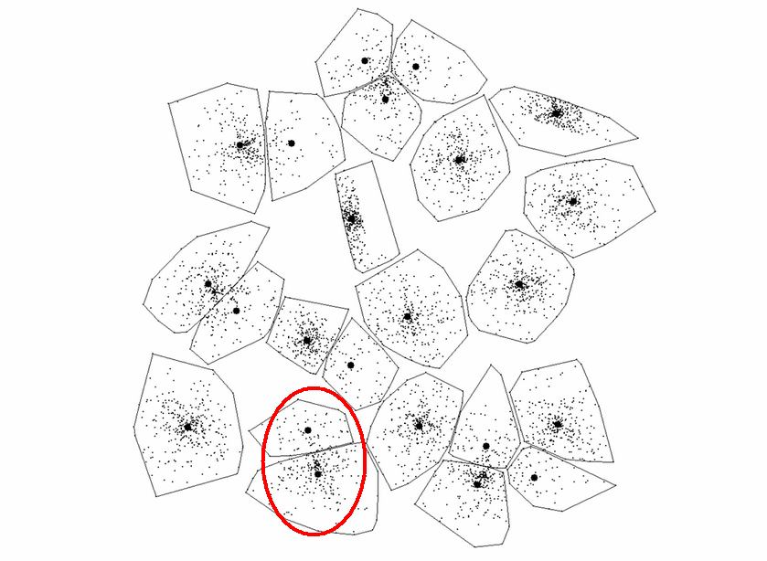
Example - 23 Clusters
MSE ≈ 1.06*10⁹

Slide 26
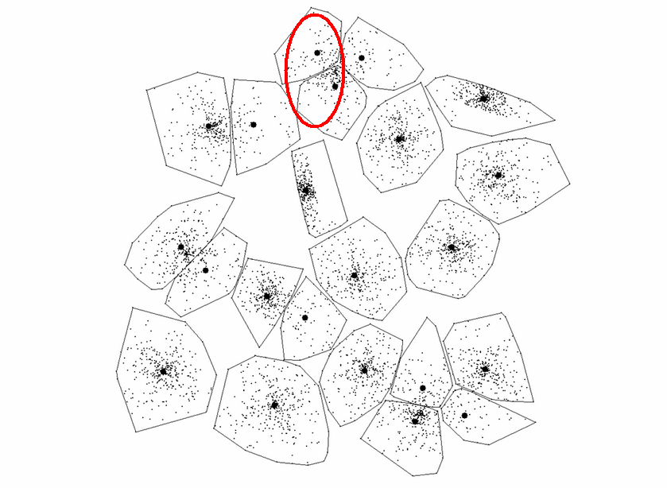
Example - 22 Clusters
MSE ≈ 1.09*10⁹

Slide 27
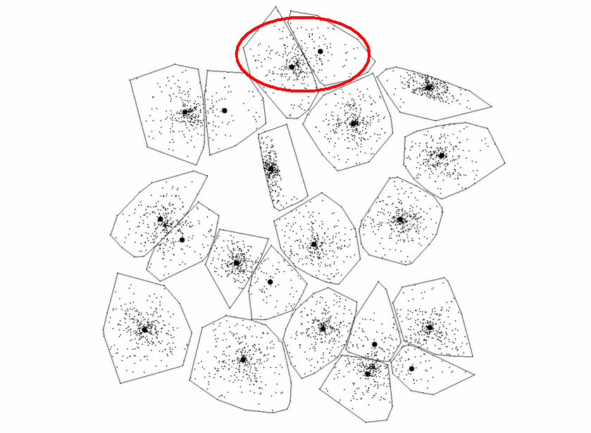
Example - 21 Clusters
MSE ≈ 1.12*10⁹

Slide 28
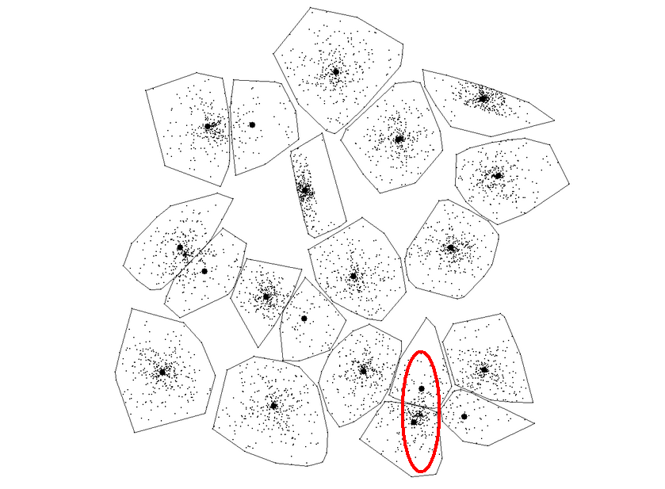
Example - 20 Clusters
MSE ≈ 1.16*10⁹

Slide 29
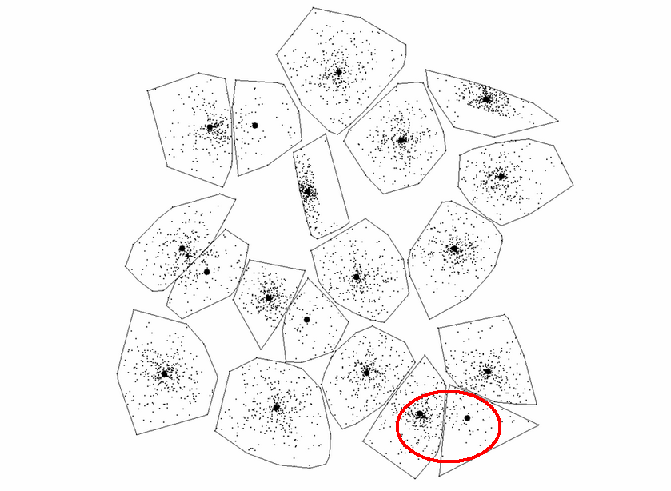
Example - 19 Clusters
MSE ≈ 1.19*10⁹

Slide 30
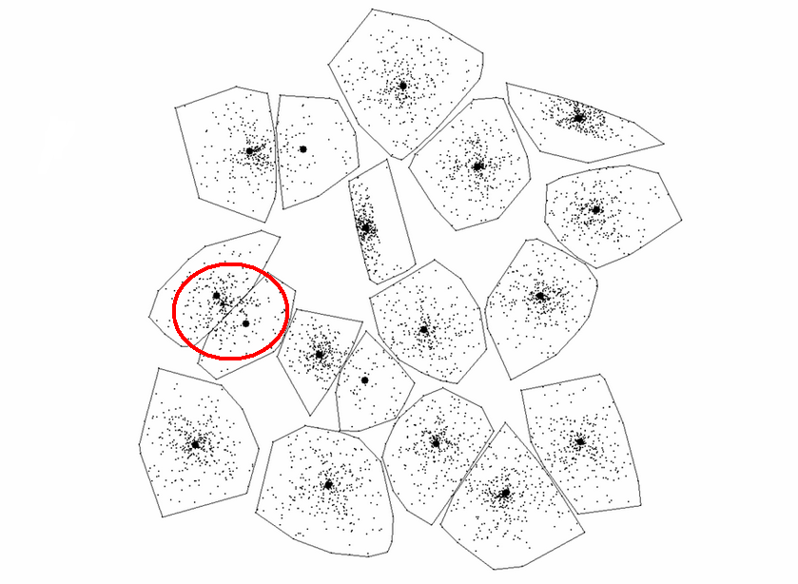
Example - 18 Clusters
MSE ≈ 1.23*10⁹

Slide 31
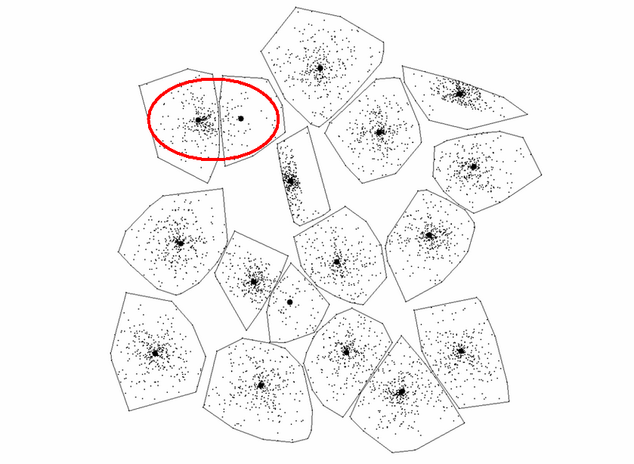
Example - 17 Clusters
MSE ≈ 1.26*10⁹

Slide 32
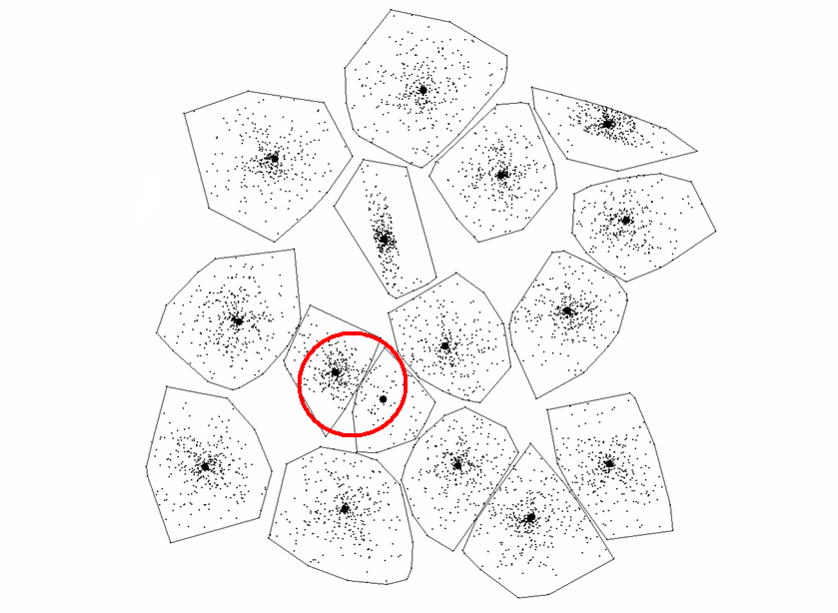
Example - 16 Clusters
MSE ≈ 1.34*10⁹

Slide 33
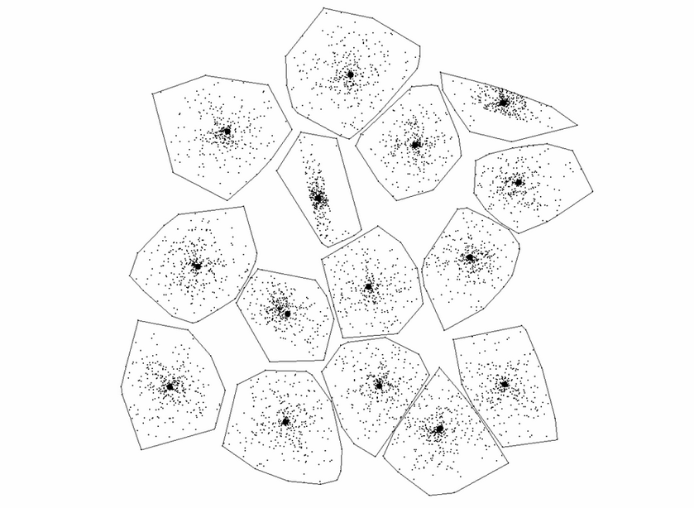
Example - 15 Clusters
MSE ≈ 1.34*10⁹

Slide 34
Revised PNN algorithm

Slide 35
Revised PNN algorithm
Complexity of Union-Find program
where n is the number of union operations and m is the number of findset operations
Traditional partitioning takes time T=NM
To query in Revised PNN algorithm is fast, when the number of queries is low

