Slide 1
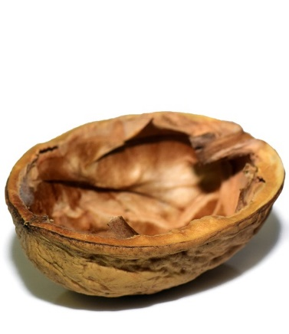

Dynamic Programming in a nutshell
Radu Mariescu-Istodor
24.9.2018

Slide 2

How many?
Notes:
I ask them to count and stop timer when I hear correct number: 18.
Then new item appears and I ask ‘How about now?’
Discussion about how they did it…

Slide 3
String distance
ALGORITHM
BIORHYTHM

Slide 4
String distance
ALGORITHM
BIORHYTHM
Hamming Distance
6

Slide 5
String distance
OR THM
ALG I
OR THM
BI HY
Edit Distance
5
Notes:
Draw the A>B and L>I substitutions
Define insertion G beween I and O
And removal H
Reuse substitution I to Y

Slide 6
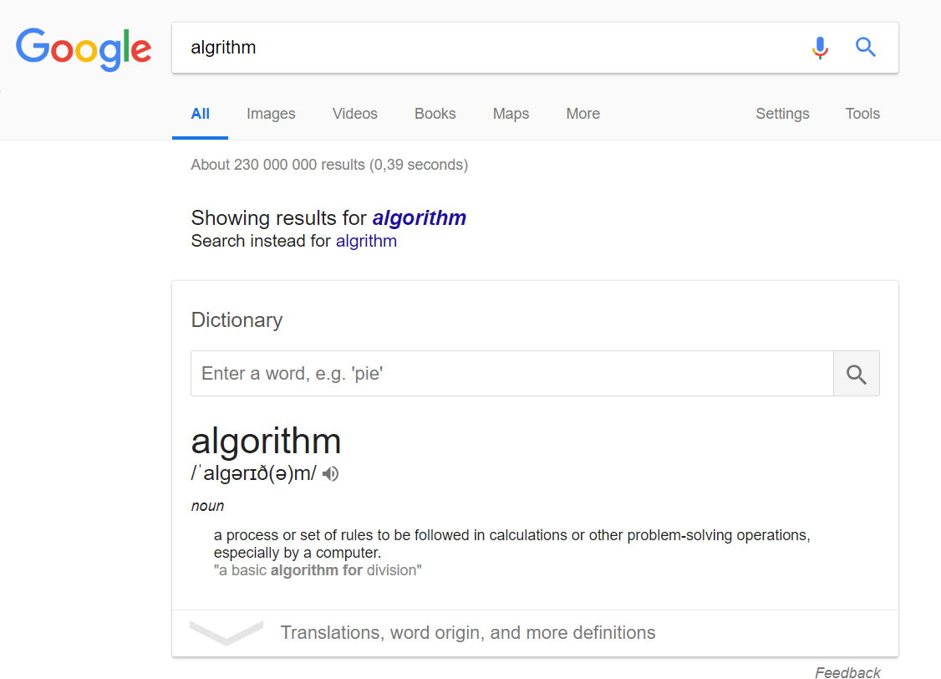
Used to Detect and Fix Typos

Slide 7
Used in DNA Sequence Alignment
ACTA-GGATTACGGGCCCGCTAC-
ACTACG-ATTA---G-CC-CTA-T

Slide 8
Three subproblems
Edit distance = 42
ACTA-GGATTACGGGCCCGCTAC-
T
ACTACG-ATTA---G-CC-CTA-T
A
42 + 1
substitution
Notes:
Must mention if They are same there is no substitution cost

Slide 9
Three subproblems
Edit distance = 43
ACTA-GGATTACGGGCCCGCTAC--
T
ACTACG-ATTA---G-CC-CTA-T
A
42 + 1
43 + 1
removal

Slide 10
Three subproblems
Edit distance = 41
ACTA-GGATTACGGGCCCGCTAC
T
ACTACG-ATTA---G-CC-CTA-T
A
42 + 1
Edit distance = min
43 + 1
41 + 1
insertion

Slide 11
Three subproblems
ACTA-GGATTACGGGCCCGCTAC
T
-
ACTACG-ATTA---G-CC-CTA-T
A
42 + 1
Edit distance = min = 42
43 + 1
41 + 1
Notes:
Edit distance is same as before.
Counterintuitive because we added different values

Slide 12
Recursive Algorithm
a[m] = b[n] or not
edit ( a[1..m], b[1..n] )
if m = 0
return n
if n = 0
return m
return min
edit( a[1..m-1], b[1..n-1]) + 0/1
edit( a[1..m-1], b[1..n] ) + 1
edit( a[1..m] , b[1..n-1]) + 1
Notes:
Algorithm can be written simply using recursion.
Click > Mention stopping criteria is necessary.
Click > Small discussion about return values
Source code:
http://cs.uef.fi/~radum/daa/dynamic_programming/edit_distance.py

Slide 13
Dynamic Programming Algorithm
B I O R H Y T H M
A
L
G
O
R
I
T
H
M
edit ( a[1..m], b[1..n] )
0 1 2 3 4 5 6 7 8 9
1 1 2 3 4 5 6 7 8 9
2 2 2 3 4 5 6 7 8 9
3 3 3 3 4 5 6 7 8 9
4 4 4
0 1 2 3 4 5 6 7 8 9
1 1 2 3 4 5 6 7 8 9
2 2 2 3 4 5 6 7 8 9
3 3 3 3 4 5 6 7 8 9
4 4 4 3 4 5 6 7 8 9
5 5 5 4 3 4 5 6 7 8
6 6 5 5 4 4 5 6 7 8
7 7 6 6 5 5 5 5 6 7
8 8 7 7 6 5 6 6 5 6
9 9 8 8 7 6 6 7 6 5
0 1 2 3 4 5 6 7 8 9
1
2
3
4
5
6
7
8
9
dist ← [m] × [n]
for col ← 1 to m+1
dist[0][col] ← col
for row ← 1 to n+1
dist[row][0] ← row
for col ← 1 to m+1
for row ← 1 to n+1
dist[row][col]← min
dist[row-1][col-1] + 0/1
dist[row-1][col] + 1
dist[row] [col-1] + 1
Notes:
Matrix to cache values

Slide 14
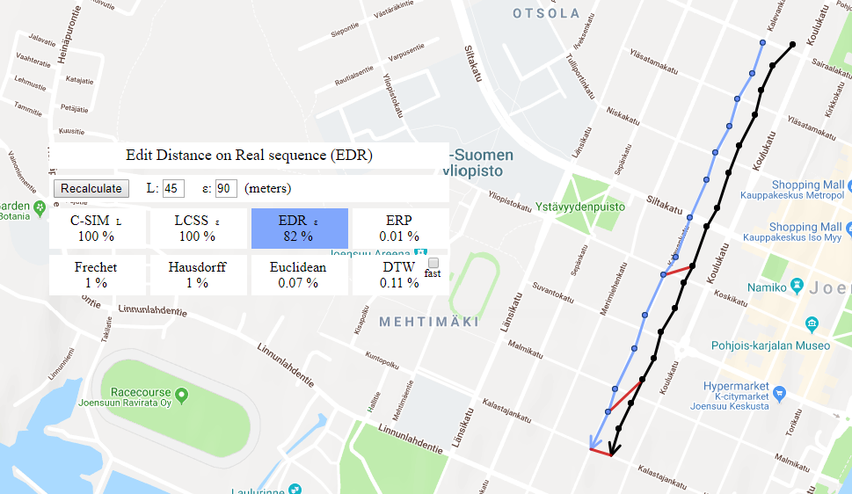
Used with GPS Trajectories
Notes:
http://cs.uef.fi/mopsi/routes/similarityApi/demo.php

